Slide 1

Nemko Canada
Sim Jagpal
V.1/2025

Slide 2
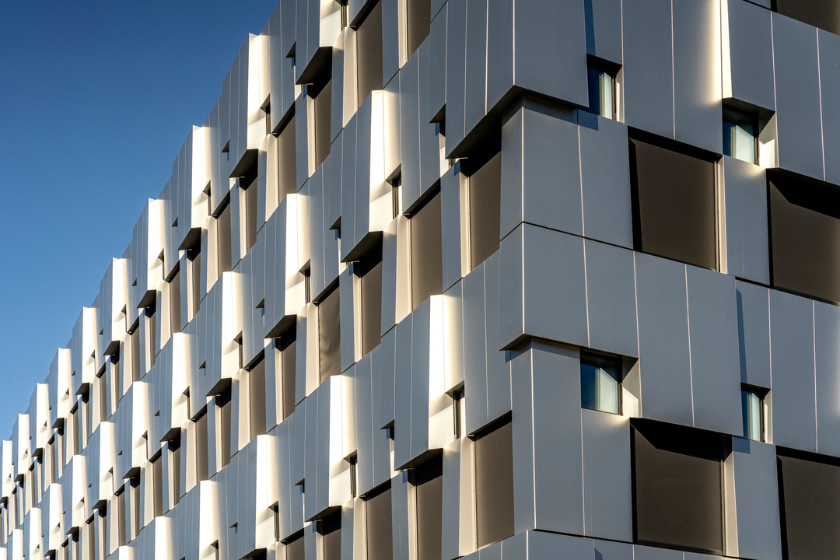
Our history
1933 | Established by the Norwegian government
1991 | Became independent self-owned private foundation
1992-2003 | Established offices and laboratories around the world 2000 Nemko in Ottawa 2013 Nemko in Montreal 2018 Nemko in Toronto
2020 | Launched Cybersecurity
2022 2024 | Merged with Sintef Norlab, adding 13 chemical testing locations in Norway Established Nemko Digital

Slide 3
Our services
Pre-compliance
Management
system certification
Product testing
Field evaluation
Product certification
Digital Trust
International approval
Sustainability

Slide 4
Our lab facilities offers
Environmental monitoring, chemical analyses (Norlab)
Energy
Safety
RoHS
EMC
Reliability,
Environmental
Wireless

Slide 5
Some of the industries we serve
Oil & gas
IT and audio/video
Maritime
Healthcare
Household
appliances
Lighting

Slide 6
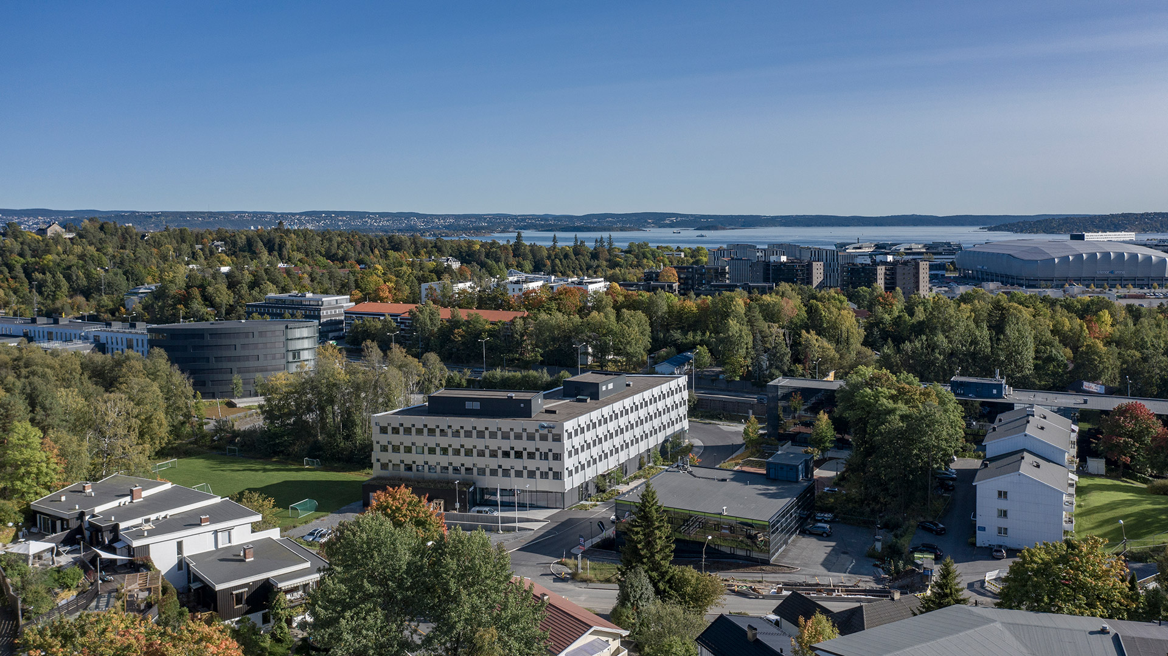
Our headquarters

Slide 7
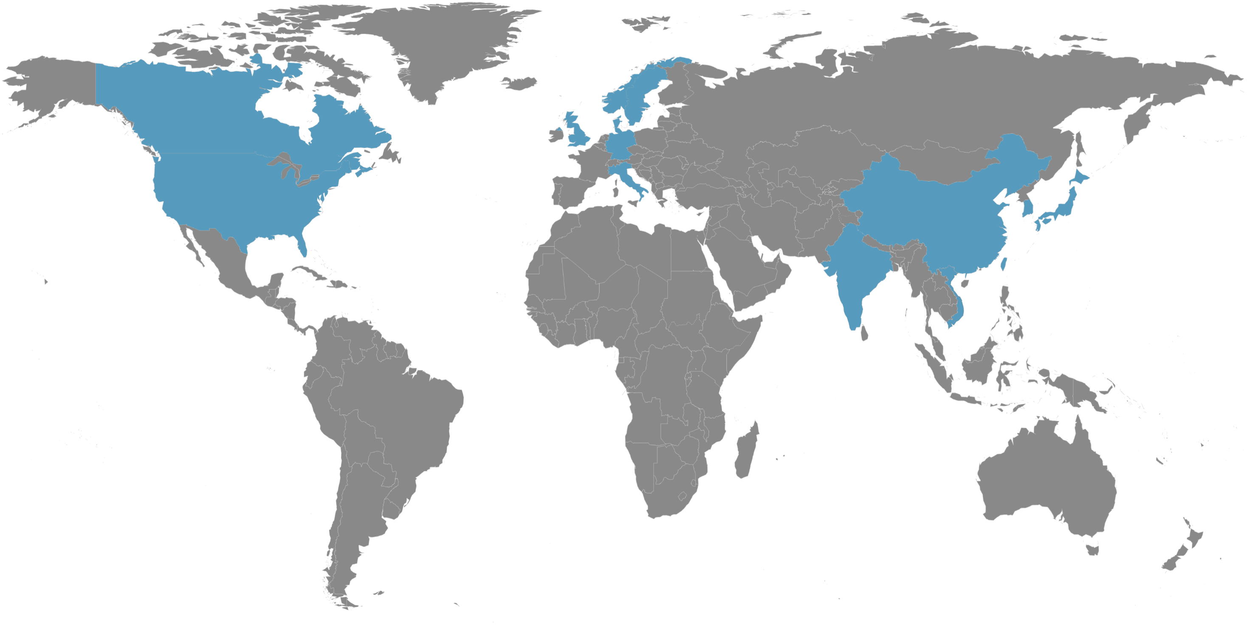
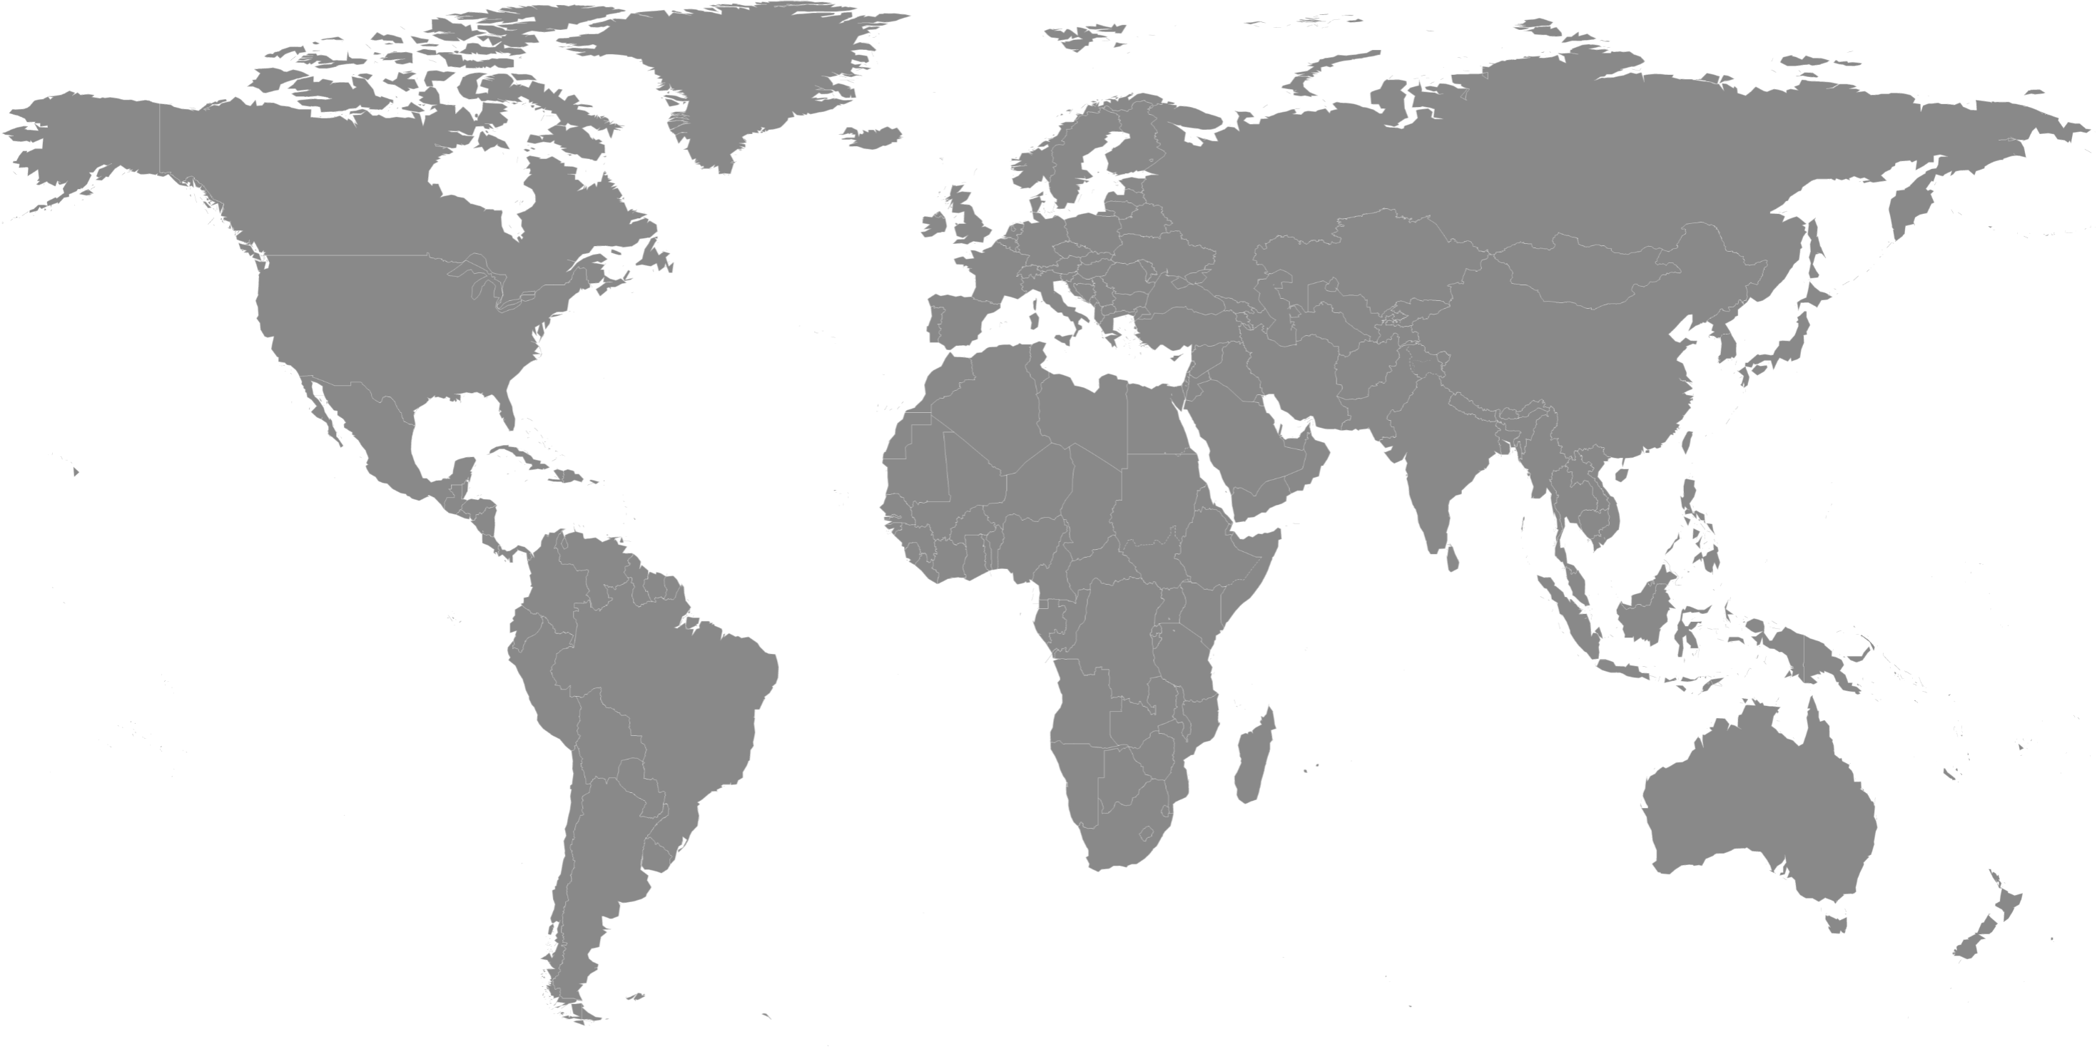
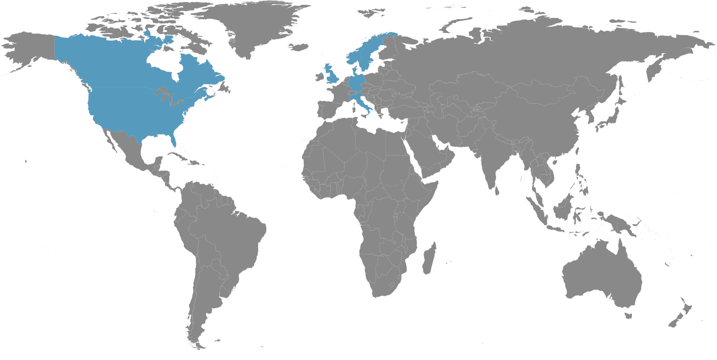
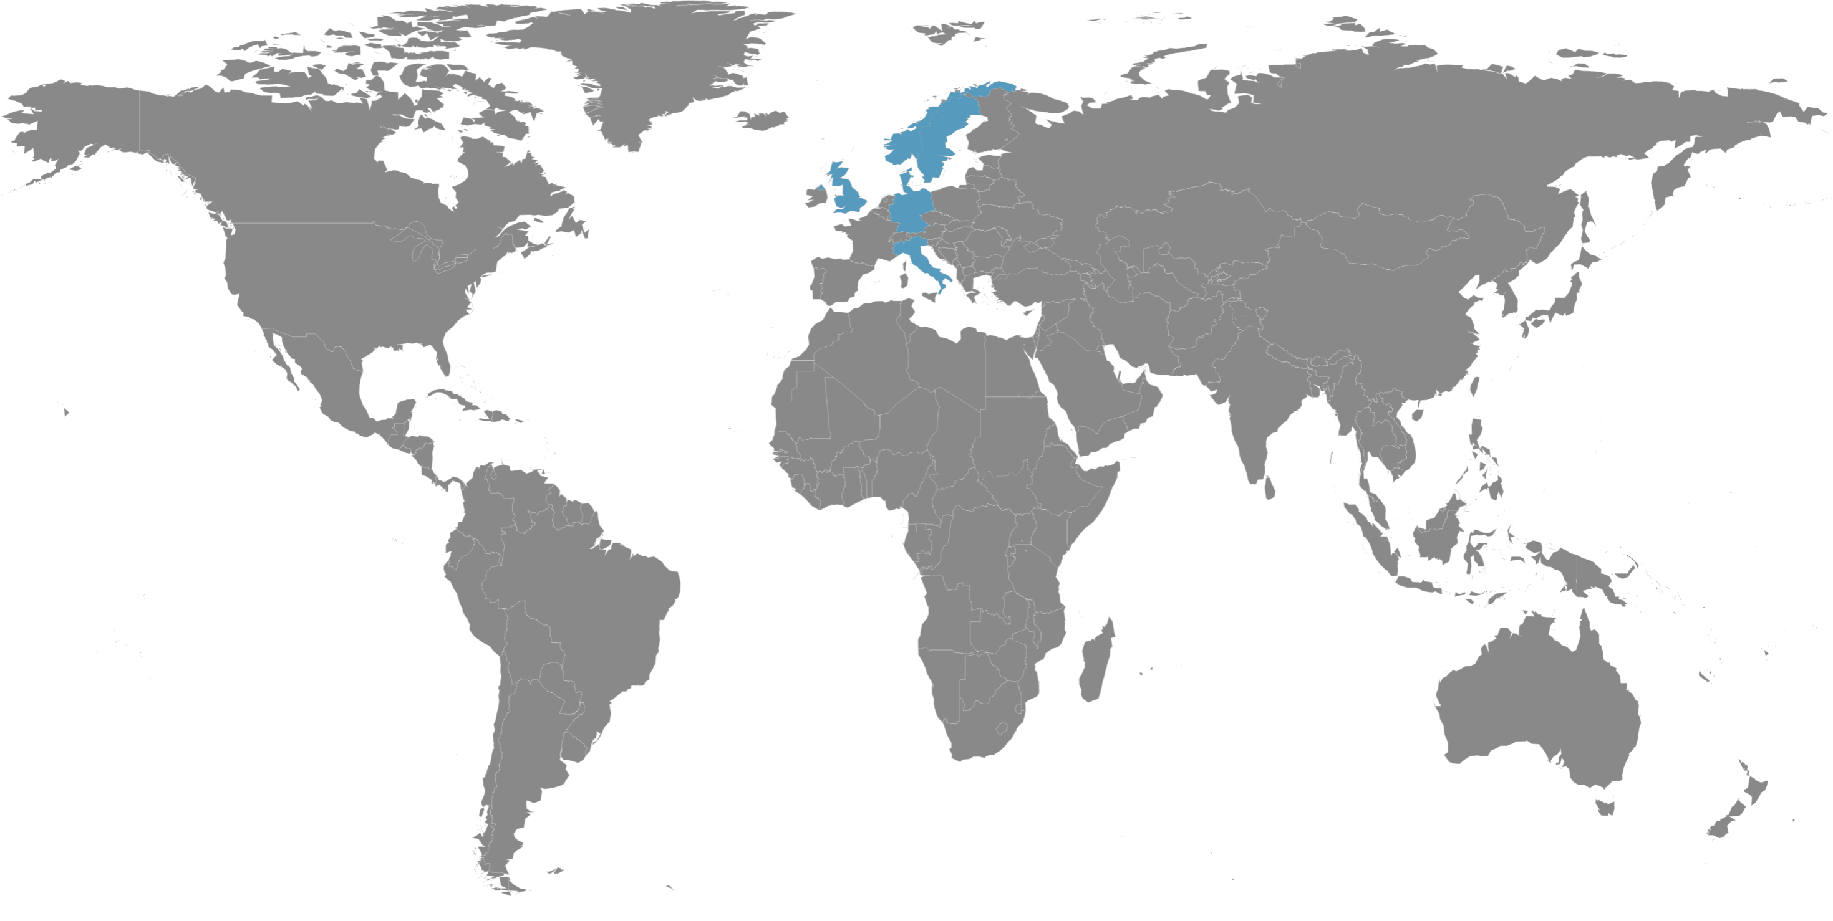
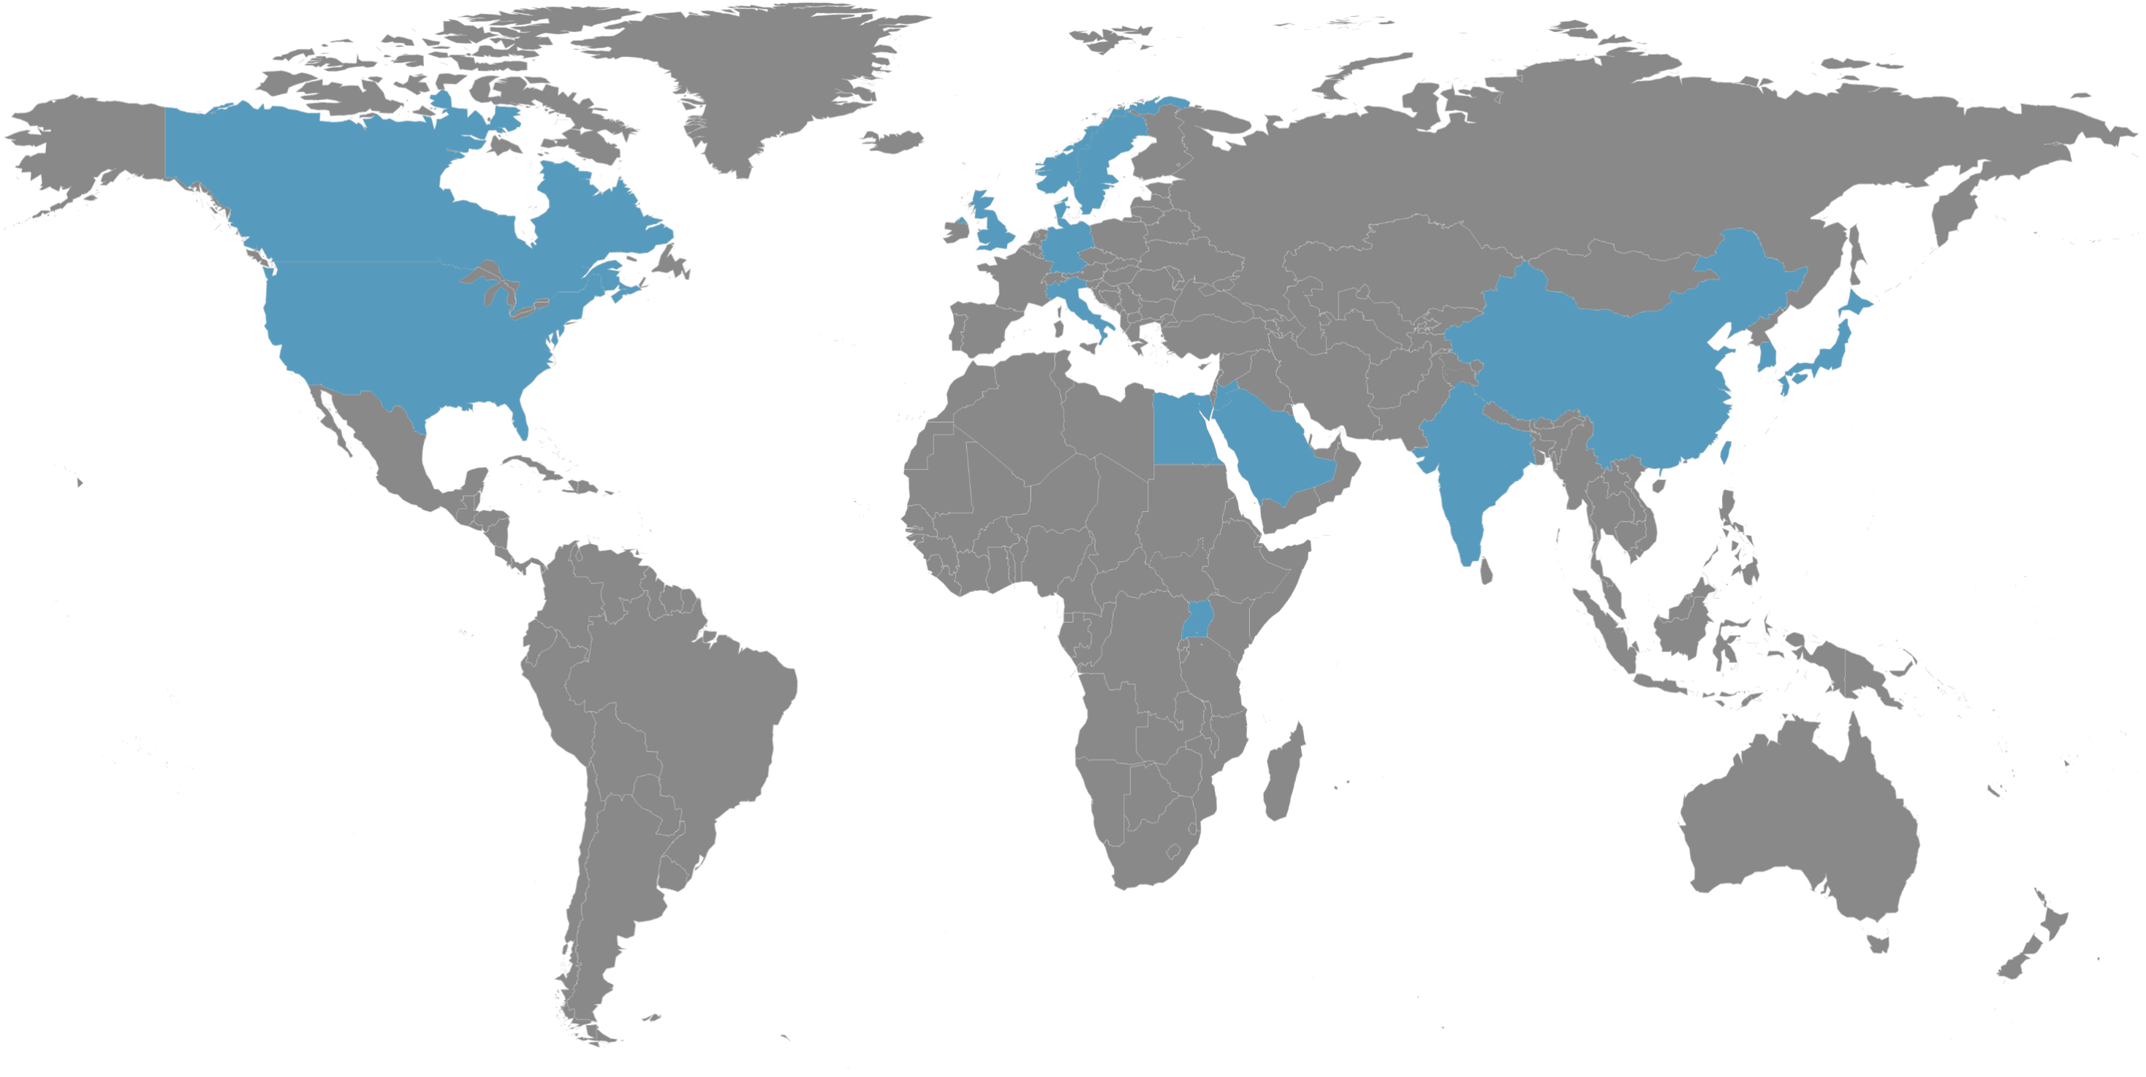
Our worldwide presence
Europe
Nemko Group, Norway
Nemko Norway
Nemko Sweden
Nemko Denmark
Nemko Germany
Nemko Italy
Nemko System Sikkerhet
Nemko Norlab
North America
Asia
Nemko Canada
  Nemko Ottawa
  Nemko Montreal
  Nemko Toronto
Nemko USA
  Nemko San Diego
  Nemko Salt Lake
  Nemko Dallas
  Nemko Austin
Nemko Beijing
Nemko Shanghai
Nemko Shenzhen
Nemko Hong Kong
Nemko Taiwan
Nemko Korea
Nemko Japan
Nemko India
Nemko representation, Vietnam
Middle East
& Africa
Nemko representation, Jordan
Nemko representation, Saudi Arabia
Nemko representation, Uganda
Nemko representation, Egypt

Slide 8
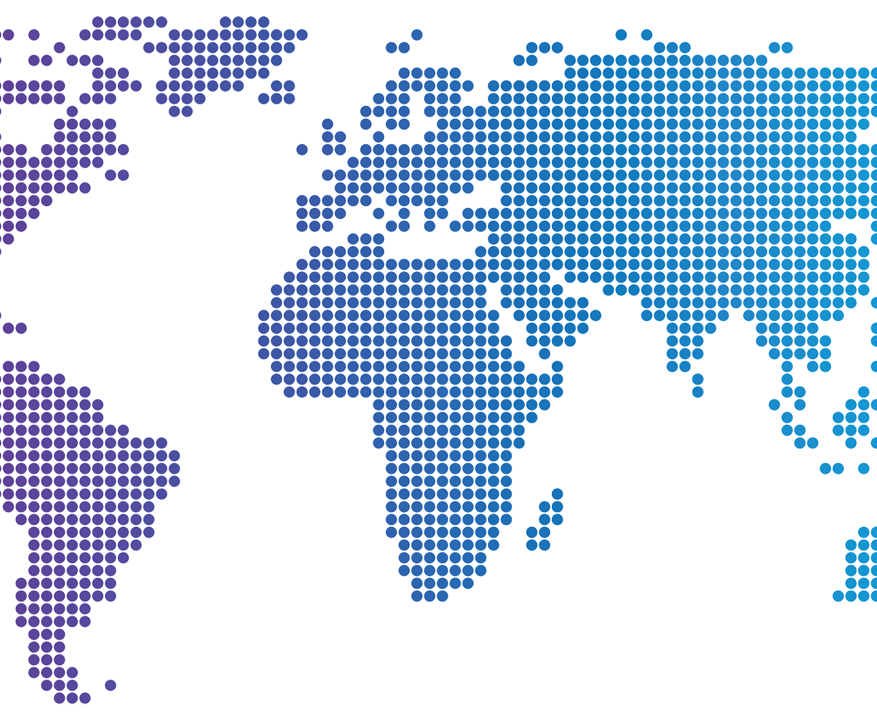
Facts & Figures
35 locations on 4 continents
More than 850 employees worldwide
Offering international approval service in more than 150 countries 9.500 customers located in 80 countries

Slide 9

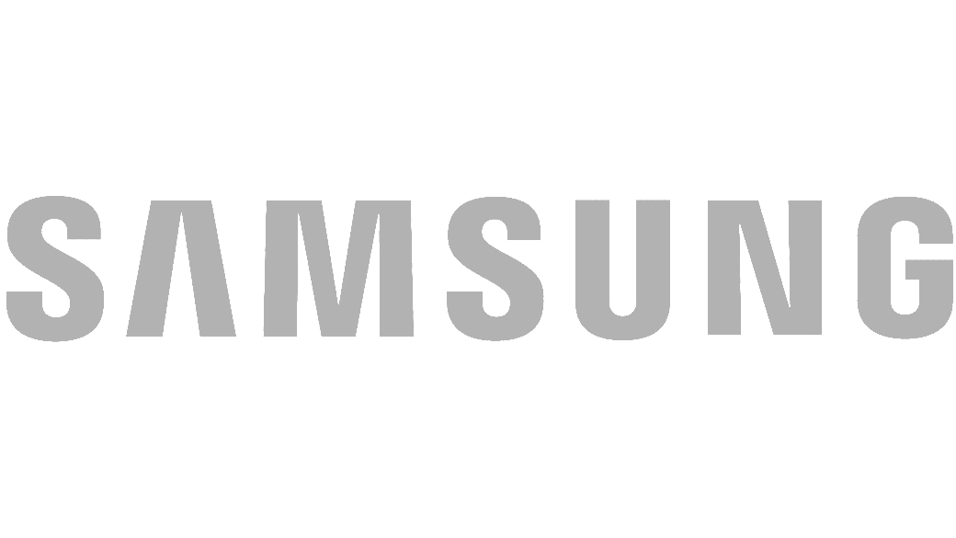


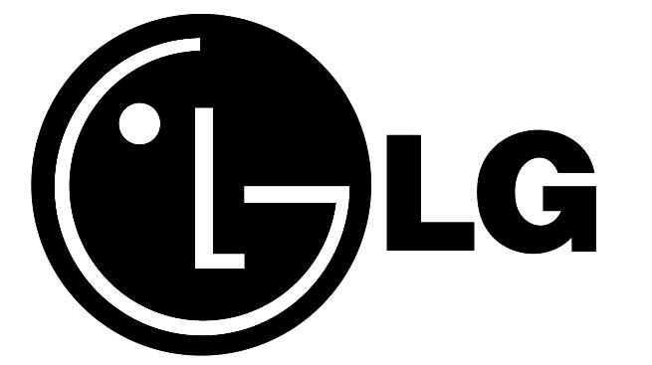

Customers
Notes:
Don’t forget to mention more customers such as DELL. We are not allowed to use all company logos. Each market can/should add a few more local companies' logos.

Slide 10

124.201 international CB Test Certificates (CBTCs) were issued in 2024
In 2023, Nemko ranked 8th globally among the 94 NCBs (National Certification Bodies), having issued 5.604 CBTCs.
We focus on the product categories HOUS (household appliances), ITAV (IT- & A/V equipment), OFF (office equipment) and TRON (audio/video equipment)
Nemko is a leading global issuer of CB certificates
Notes:
Skule? Market access / International approval??

Slide 11
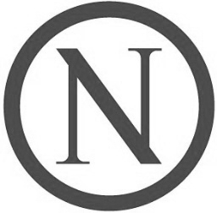
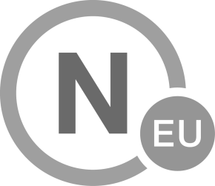
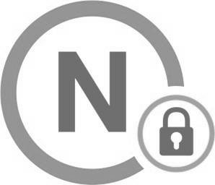
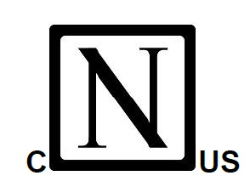
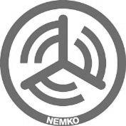
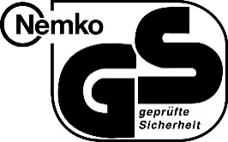

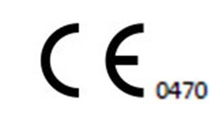
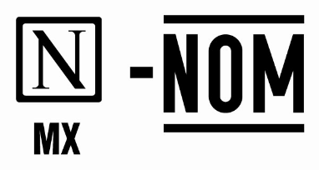
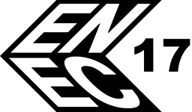
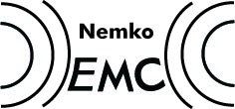

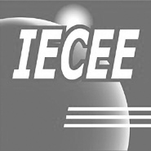
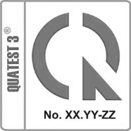



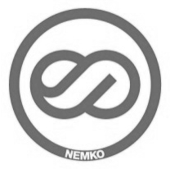
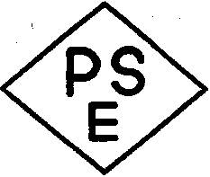


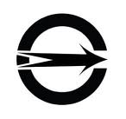
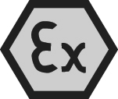

Certifications we offer
Notes:
Check with Stuart? ADD FCC USA???

Slide 12
Our guidance

Slide 13


Our vision
    Nemko makes the world a safer place
Mission statement
    Nemko ensures the safety, security and sustainability of products and systems, by providing third-party assurance and global market access solutions

Slide 14
Values

Slide 15




We…
Deliver a great customer experience
Promote continuous learning and development
Care for people and the environment
Demonstrate integrity and deliver quality

Slide 16
Thank you!

